Slide 1

FM-INDEX
Data Structures II Project Presentation
Amortized properties:
Samarah sahto, Shafaq Mughal,
shayan aamir, zoha ovais Karim

Slide 2


Why we chose FM INDEX (Full-text index in Minute space)
Interesting Application
Similar to Suffix Tree

Slide 3
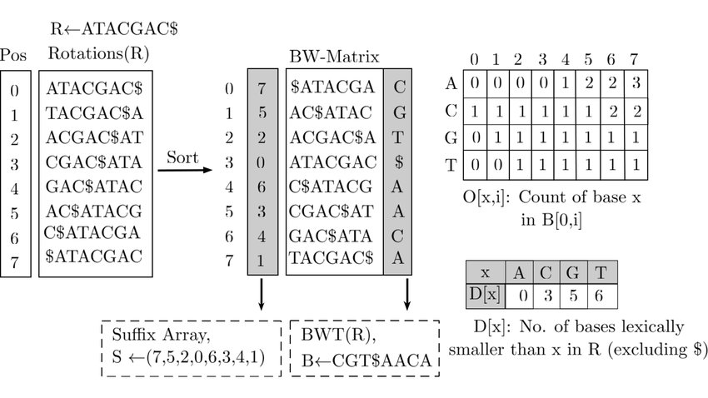
How does FM-Index Work?
Data Compression
Takes the Burrows Wheel Transform
Counts and locates

Slide 4
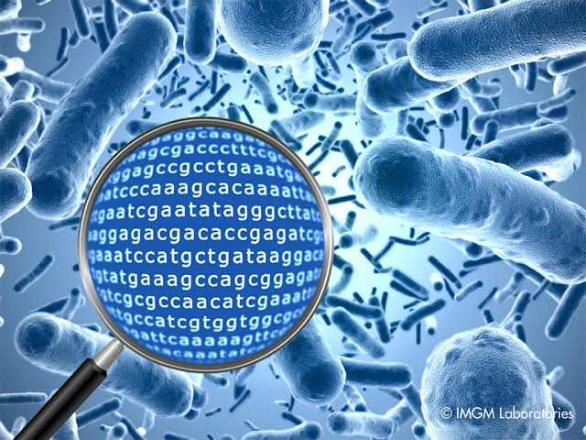
Our Problem…
Help a scientist work on DNA.
Pattern location in a large DNA data set.
Gene Correction and Analysis.

Slide 5
Operations that our Application Performs
Search
Analyze
Correct

Slide 6

Now lets look at our application that solves this problem!

Slide 7
Time Complexities for Searching Where n = length of data set, m = length of pattern, k = number of occureences
FM Index
Linear Search
Suffix Tree
Rabin Karp
O(m)
O(nm)
O(m+k)
O(nm)

Slide 8
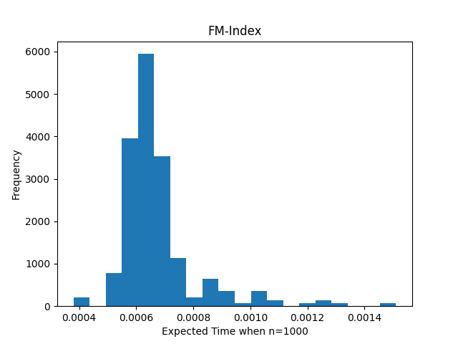
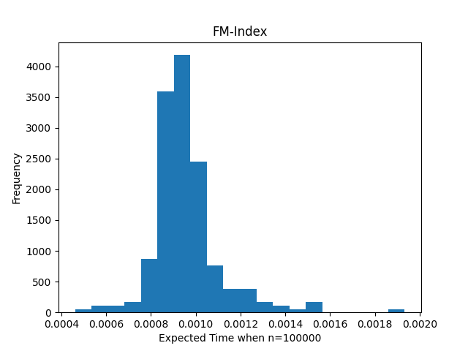
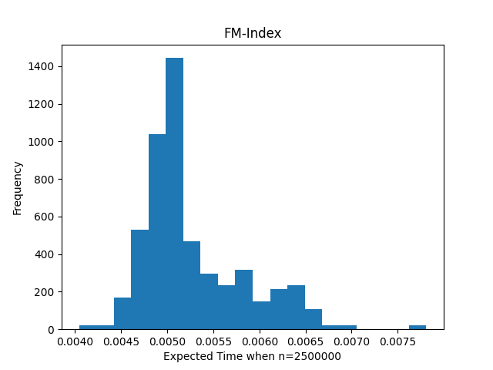
Analysis - FM INDEX
n=1000
n=100000
n=2500000

Slide 9
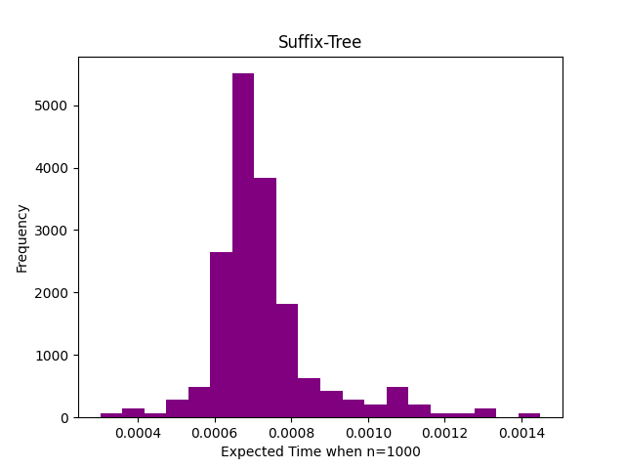
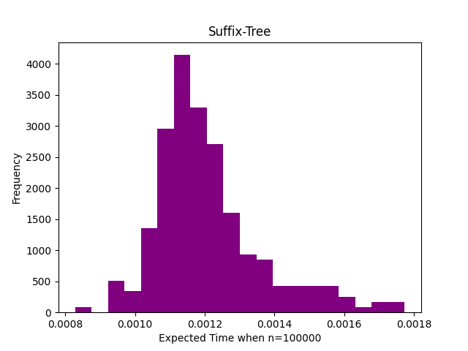
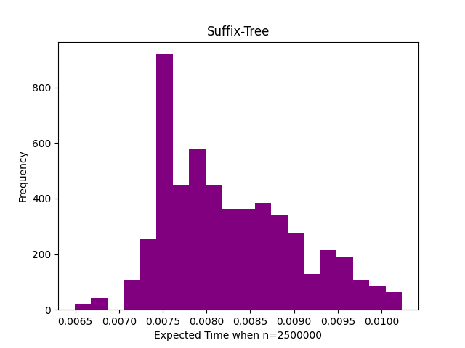
-Suffix Tree
n=1000
n=100000
n=2500000

Slide 10
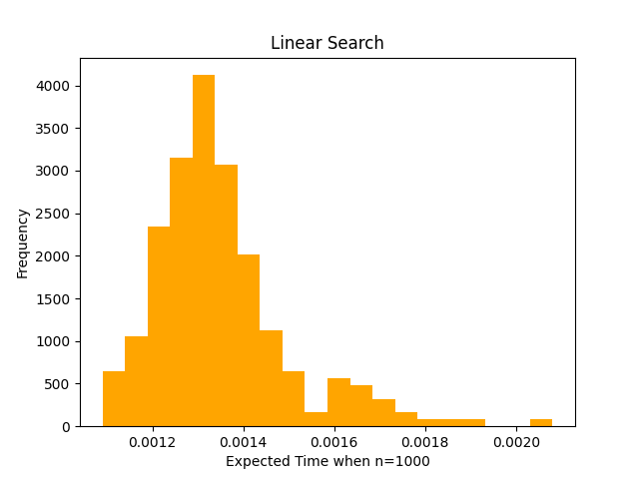
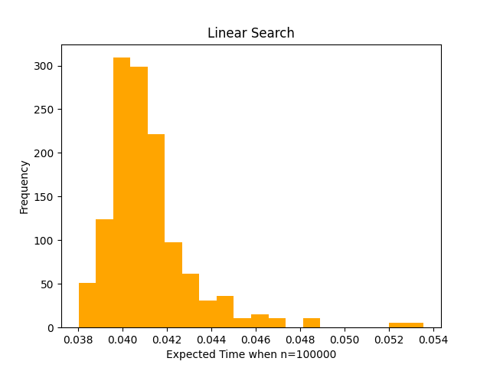
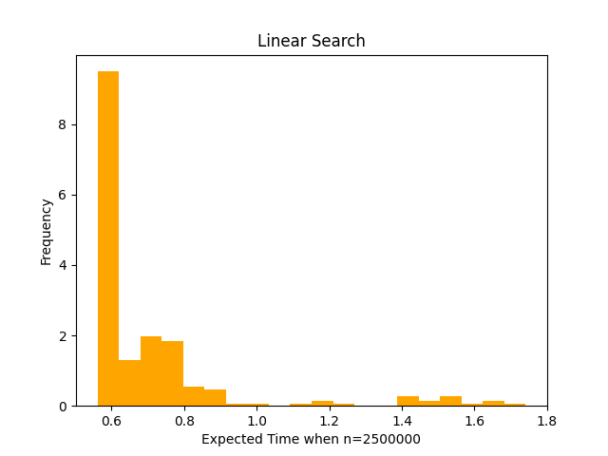
-Linear Search
n=1000
n=100000
n=2500000

Slide 11
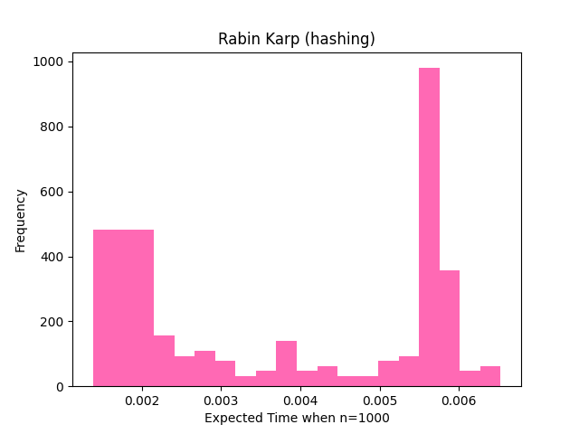
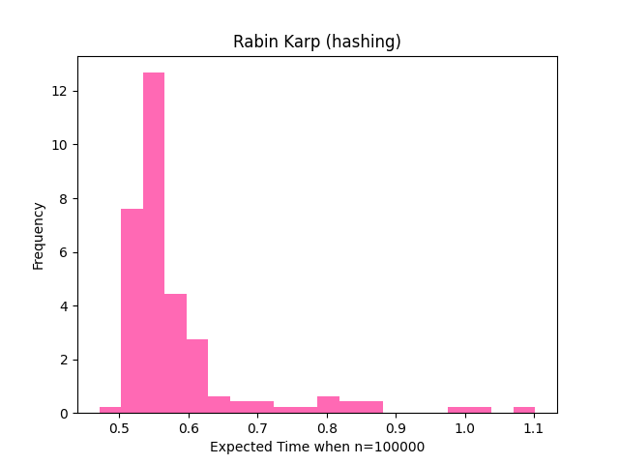
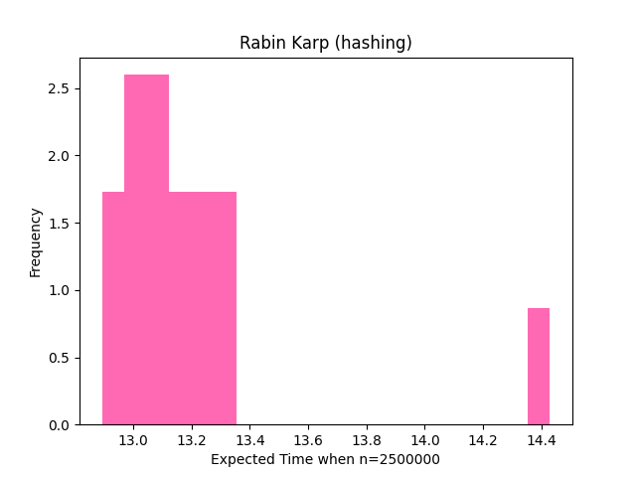
- Rabin Karp
n=1000
n=100000
n=2500000

Slide 12

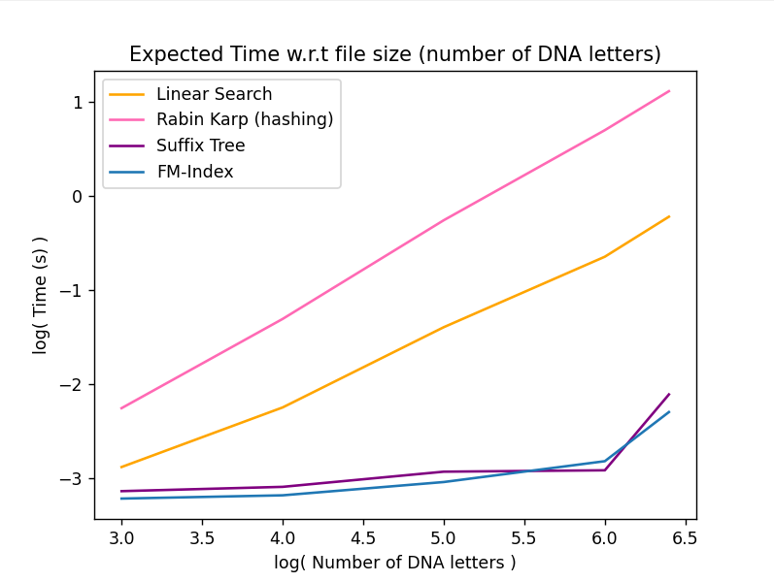
Why FM Index?
Why FM Index?
Why FM Index?
Expected Search Time line plot

Slide 13
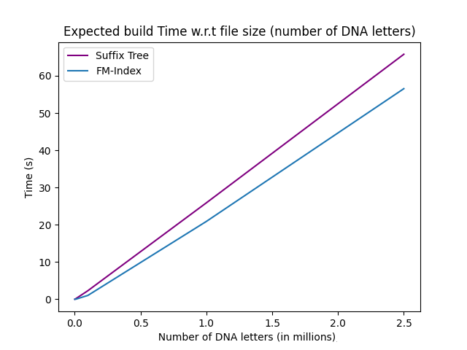
Why FM Index?
Expected Time taken to build the structures

Slide 14
References
https://www.geeksforgeeks.org/pattern-searching-using-suffix-tree/
https://www.geeksforgeeks.org/burrows-wheeler-data-transform-algorithm/
https://www.geeksforgeeks.org/suffix-array-set-1-introduction/
https://www.geeksforgeeks.org/rabin-karp-algorithm-for-pattern-searching/
https://academic.oup.com/bioinformatics/article/34/3/416/4160683
https://www.labri.fr/perso/ruricaru/bioinfo_master2/cours3.pdf
https://users.dcc.uchile.cl/~gnavarro/ps/psc05.3.pdf
https://www.youtube.com/watch?v=kvVGj5V65io
http://www.cs.jhu.edu/~langmea/resources/lecture_notes/10_bwt_and_fm_index_v2.pdf
https://github.com/ptrus/suffix-trees
https://github.com/mccricardo/Rabin-Karp
Want to take a look at our project?
Here Is the link to our GitHub repository:
https://github.com/ShafaqFatimaMughal/amortized-properties.git

Slide 15
Thank you
Merci
Khop Khun Mak Kha.
Grazie
Gracias
Danke sehr
شکریہ
Arigato

